Slide 1
Key SDH Graphs
Ambulatory & Newborn Clinics

Slide 2
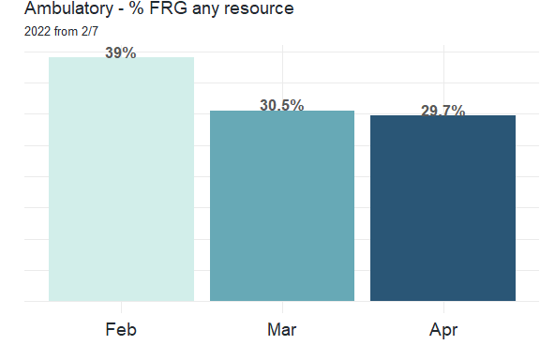
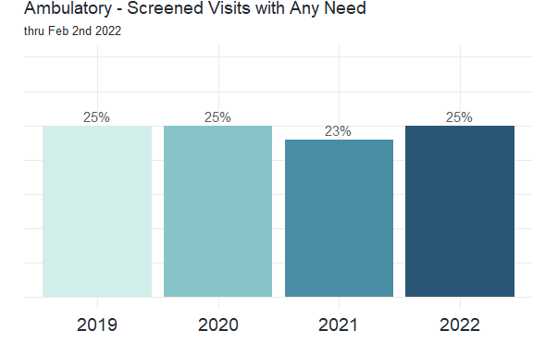
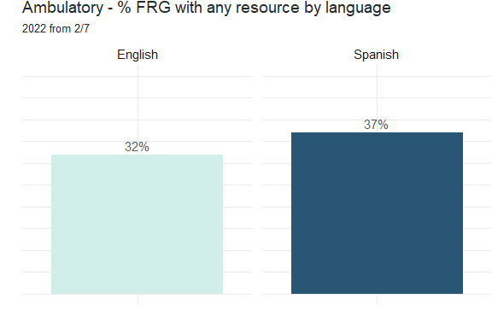
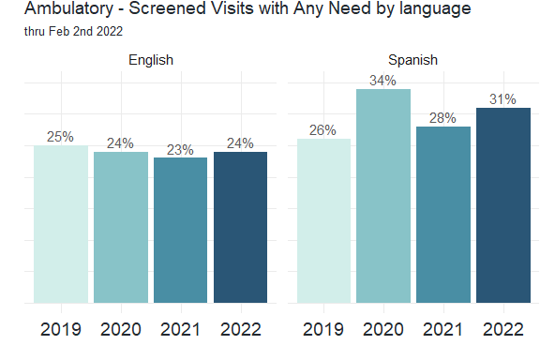
COMPARING ANY RESPONSE ON FRG (LEFT) VS MLP (RIGHT)

Slide 3
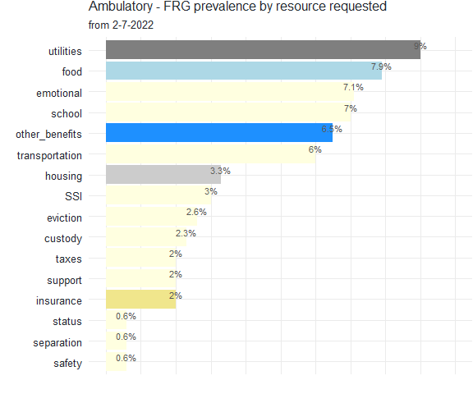
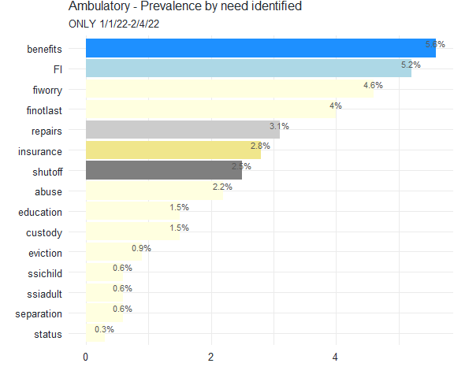
COMPARING PREVALANCE BY TOPIC ON FRG (LEFT) VS MLP (RIGHT)
MLP ONLY first 5 weeks of 2022 for most current comparison

Slide 4
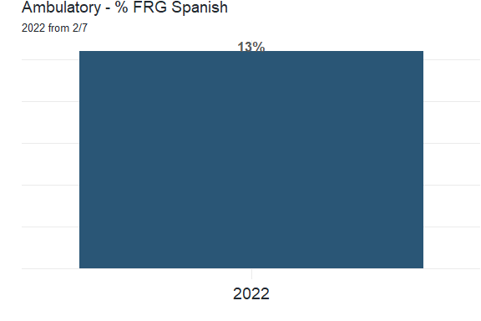
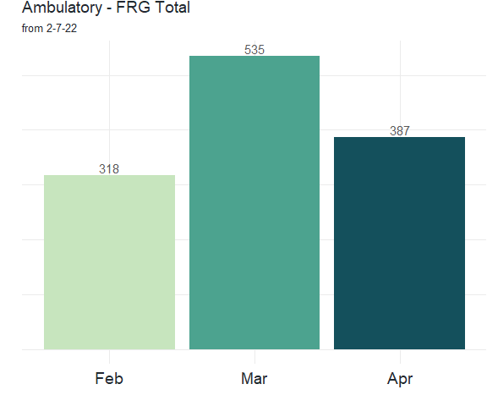
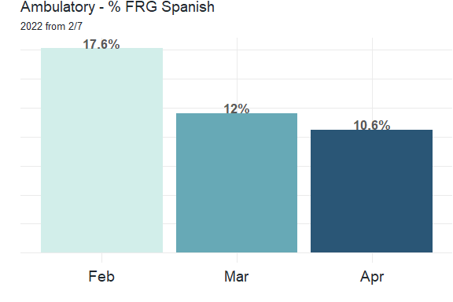
FRG
From: R/PhilaKids/REDCap/FRG_2022.rmd
Last updated: 6/21/22

Slide 5
FRG
From: R/PhilaKids/REDCap/FRG_2022.rmd
Last updated: 6/21/22
From: R/PhilaKids/REDCap/FRG_2022.rmd
Last updated: 6/21/22

Slide 6
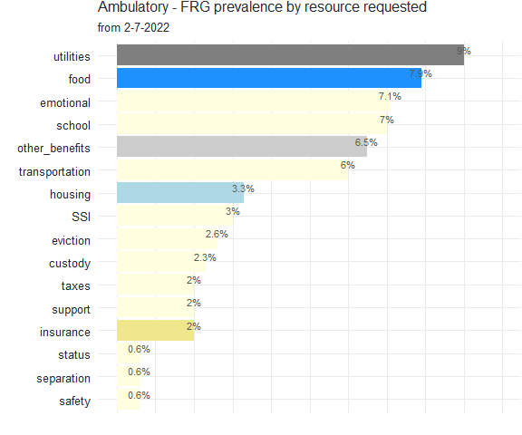
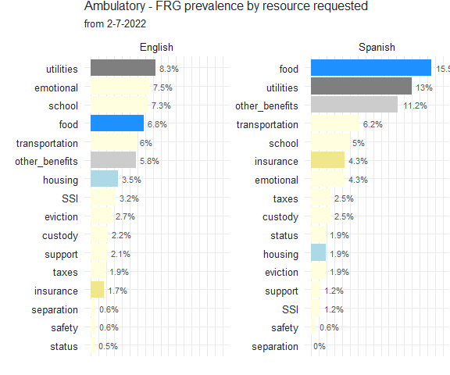
FRG
From: R/PhilaKids/REDCap/FRG_2022.rmd
Last updated: 6/21/22
From: R/PhilaKids/REDCap/FRG_2022.rmd
Last updated: 6/21/22

Slide 7
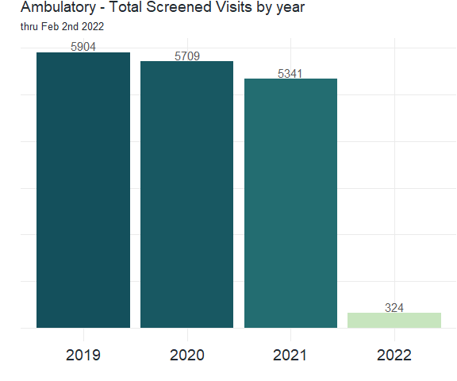
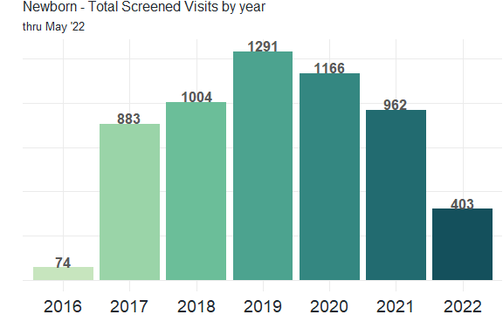
From: R/newborn/key_graphs_newborn.rmd
Last updated: 6/21/22
From: R/PhilaKids/REDCap/key_graphs_RCMLP.rmd
Last updated: 6/21/22

Slide 8
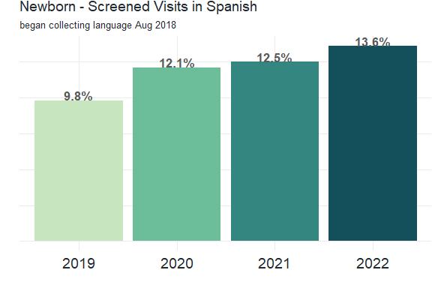
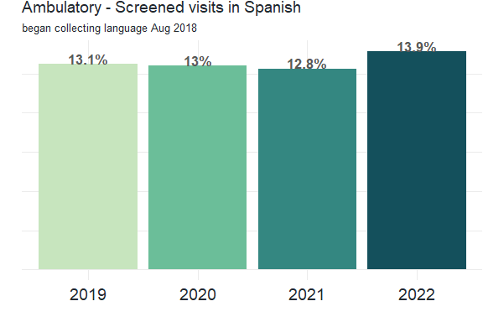
From: R/newborn/key_graphs_newborn.rmd
Last updated: 6/21/22
From: R/PhilaKids/REDCap/key_graphs_RCMLP.rmd
Last updated: 6/21/22

Slide 9
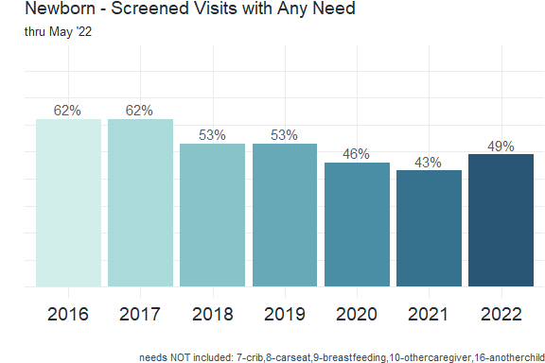
From: R/newborn/key_graphs_newborn.rmd
Last updated: 6/21/22
From: R/PhilaKids/REDCap/key_graphs_RCMLP.rmd
Last updated: 6/21/212

Slide 10
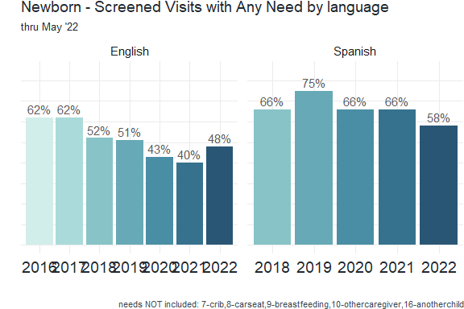
From: R/newborn/key_graphs_newborn.rmd
Last updated: 6/21/22
From: R/PhilaKids/REDCap/key_graphs_RCMLP.rmd
Last updated: 6/21/22

Slide 11
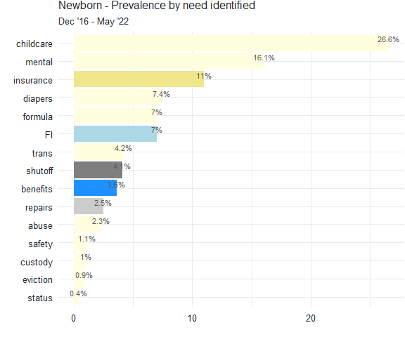
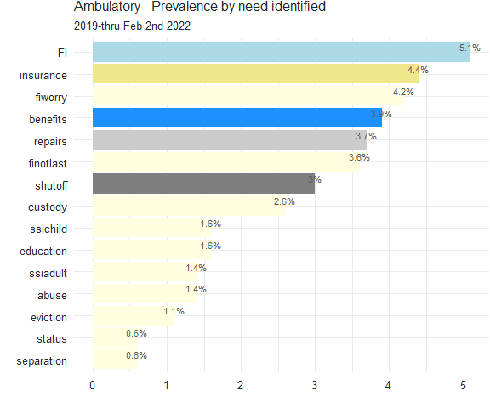
From: R/newborn/key_graphs_newborn.rmd
Last updated: 6/21/22
From: R/PhilaKids/REDCap/key_graphs_RCMLP.rmd
Last updated: 6/21/22

Slide 12
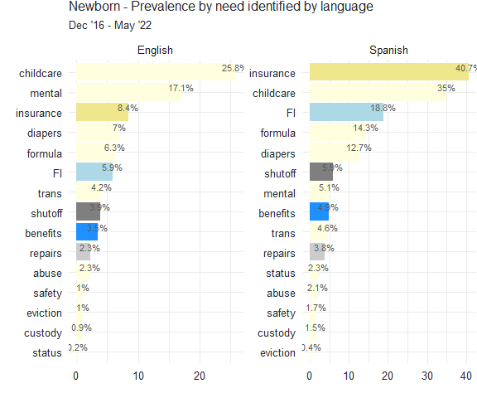
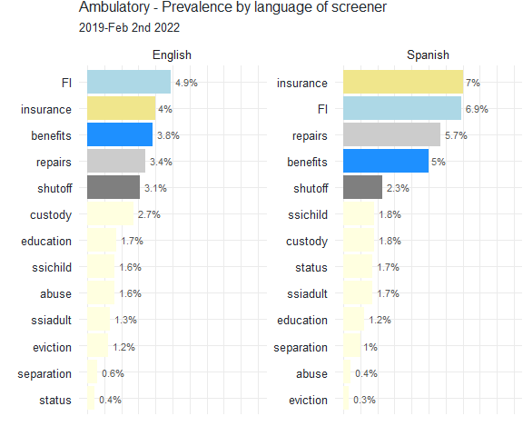
From: R/newborn/key_graphs_newborn.rmd
Last updated: 6/21/22
From: R/PhilaKids/REDCap/key_graphs_RCMLP.rmd
Last updated: 6/21/22

Slide 13
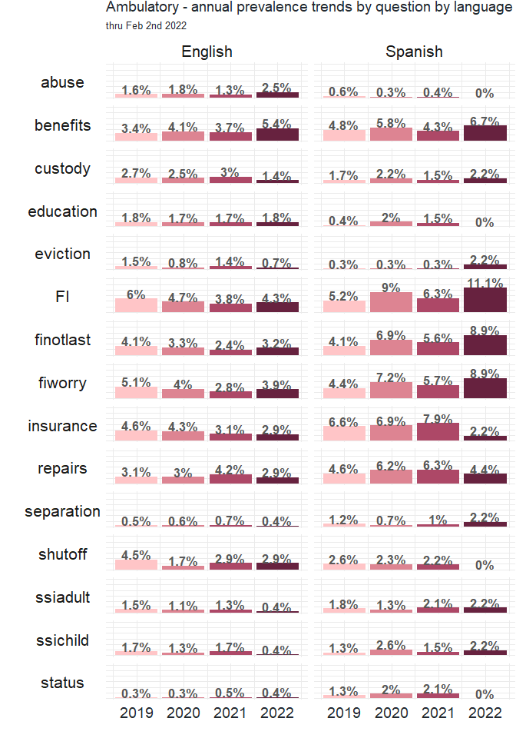
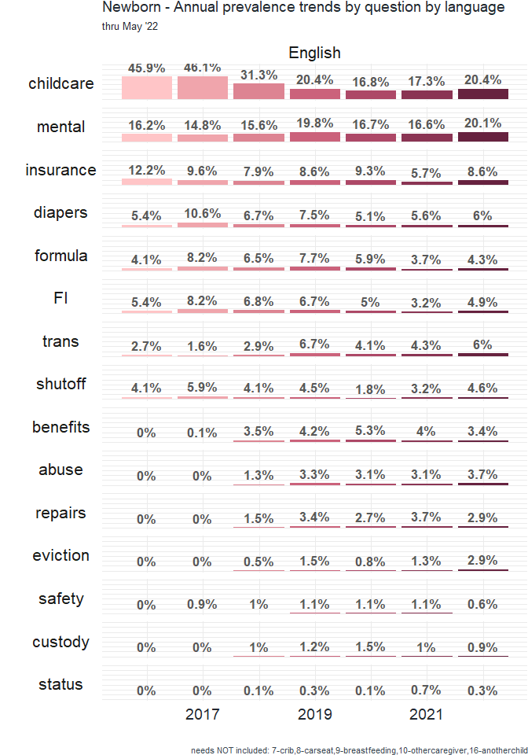
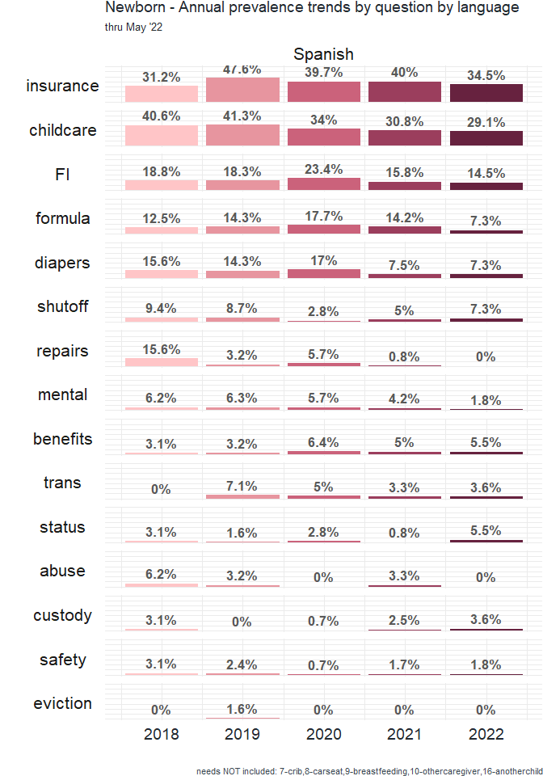
From: R/newborn/key_graphs_newborn.rmd
Last updated: 6/21/22
From: R/PhilaKids/REDCap/key_graphs_RCMLP.rmd
Last updated: 6/21/22

Slide 14
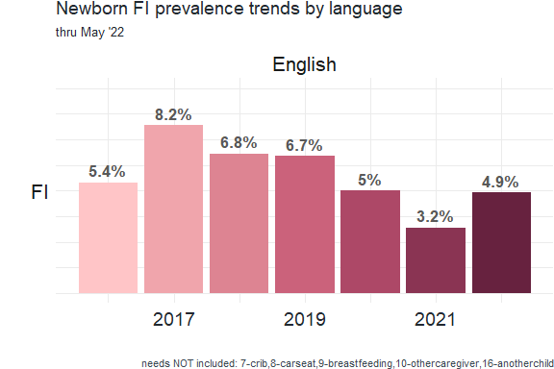
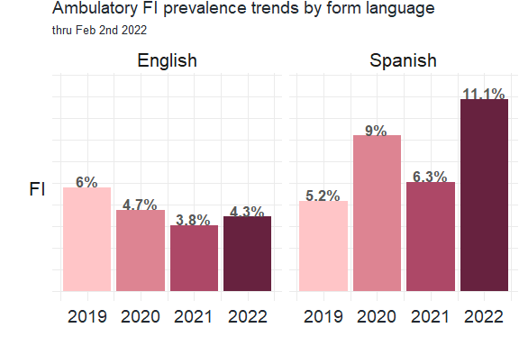
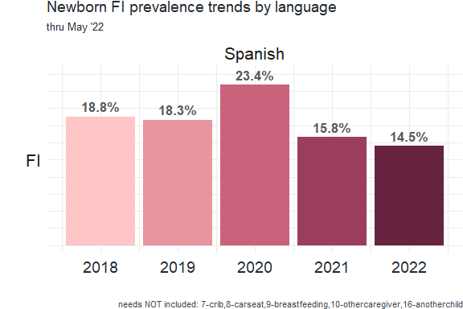
From: R/PhilaKids/REDCap/key_graphs_RCMLP.rmd
Last updated: 6/21/22
From: R/newborn/key_graphs_newborn.rmd
Last updated: 6/21/22

