Slide 1
Introduction to Public Benefits
A Noon Advocacy Lecture Presented by
PHILAKids|MLP
May 16, 2015

Slide 2
Road Map
Refresher on MLP
Eligibility for public benefits
Overview of various benefits
How we can help families together!

Slide 3
Why Legal Advocacy in the
Clinical Setting?
Physicians and other health care providers are trusted, credible resources
Screening for legal issues in the clinical setting facilitates preventive law
Improves access to remedies for social determinants of health

Slide 4
What are the areas of focus?:
I-HELP
Income/Insurance Supports
  Public Benefits
  Supplemental Security Income (SSI)/Social Security Disability Insurance (SSDI)
  Food Stamps
  Insurance Access and Benefits
Housing
  Shelter Access
  Access to Subsidies
  Utilities
Education
  Individuals with Disabilities in Education Act (IDEA)
  ADA
Legal Status
  Immigration
Personal Stability and Safety
  Guardianship, Custody, Divorce
  Domestic Violence
  Personal Planning Documents (Wills, Powers of Attorney, Living Wills)
Source: National Center for Medical-Legal Partnership
© 2008-2009 MLP Boston

Slide 5
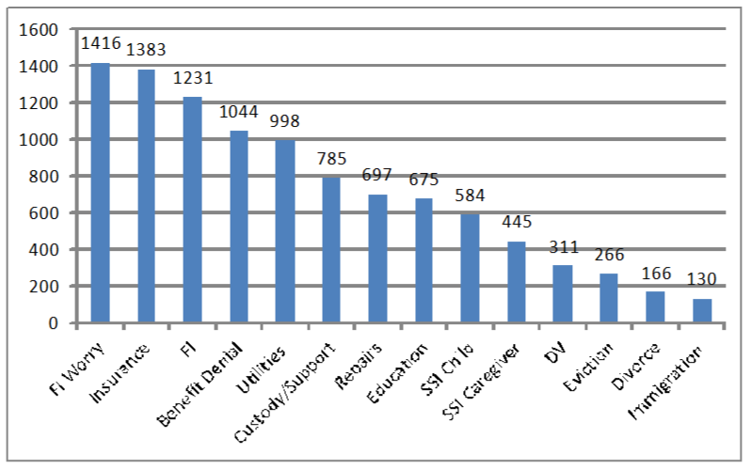
Snapshot: St. Chris MLP
Screened over 13,000 families since 2012
46% self report at least one unmet legal need
As a whole, public benefits and income supports make up the largest need

Slide 6
Why do families need benefits?
Single parent with an two children in Philadelphia County needs to earn $27.03/per hour to be self-sufficient
Starting wages for:
  Home Health Aide $10.38/hour
  Certified Nursing Assistant $12.23/hour
  Licensed Practical Nurse $19.19/ hour
Public Benefits help fill the gap
Notes:
http://pathwayspapolicyblog.com/2010/06/self-sufficiency-standard-presentation.html

Slide 7
Public Benefits Overview
Food | Income Support | Housing | Medical
SNAP/ food stamps | SSI/ SSDI | PHA | Medical Assistance
WIC | TANF | Section 8 | CHIP
 | Child Support | HUD
 | Kinship Care | Shelters

Slide 8
Alphabet Soup
DHS – Department of Human Services
DPW – Department of Public Welfare (Now also called DHS)
EBT – Electronic Benefits Transfer
HUD – Housing and Urban Development
PHA – Philadelphia Housing Authority
SNAP – Supplemental Nutrition Assistance Program
SSDI – Social Security Disability Insurance
SSI – Supplemental Security Income
TANF – Temporary Assistance for Needy Families
WIC – Women, Infants and Children

Slide 9
Eligibility for benefits depend on income
2016 POVERTY GUIDELINES
Programs use the Federal Poverty Guidelines to determine eligibility
Referred to as the
Federal Poverty Level
(FPL)
The baseline is
100% FPL
Persons in family/household | Poverty guideline
1 | $11,880
2 | 16,020
3 | 20, 160
4 | 24,300
5 | 28,440
6 | 32,580
7 | 36,730
8 | 40,890
For families/households with more than 8 persons, add $4,160 for each additional person.

Slide 10
Public Benefits and Income Eligibility
BENEFIT | TO BE ELIGIBLE, YOU HAVE TO BE UNDER:
Cash Assistance (aka: TANF, welfare) | 49% FPL
Food Assistance (aka: food stamps, SNAP) | 160% FPL
Medicaid for parents | 138% FPL
Medicaid for children | About 200% FPL
WIC | 185% FPL
Day care vouchers | 235%FPL

Slide 11
Verifications for Cash Assistance/Food Stamps/Medical Assistance
Household Verification filled out by your landlord or a disinterested third party
Proof of your employment for the last 6 months – how much you’ve earned, start and end dates at each job
Copy of your most recent bank statement on your checking and savings accounts
Statements from any type of 401K or pension that you have
Information about any insurance policies (ie: life insurance)
Copy of the title to your car(s)

Slide 12

Food Stamps
SNAP (Supplemental Nutrition Assistance Program) commonly referred to as food stamps
  Average monthly benefit per person is $128
  Through the DPW
  Must reapply every six months
  Must be a U.S. citizen
    Children born in the U.S. are eligible even if both parents are not citizens
What about multi-family households?

Slide 13

Food Stamps
EBTs on ACCESS card
  Swipe it like any debit card at the grocery store
  Benefits are loaded between the 1st and 10th of the month

Slide 14
Food Stamps
Family Size | Monthly allotment
2 | $357
3 | $511
4 | $649
5 | $771
Notes:
Data from http://www.dpw.state.pa.us/foradults/supplementalnutritionassistanceprogram/D_000639 (accessed Feb. 12, 2014)
Reflects decrease as of November 1, 2013

Slide 15
What can I buy with food stamps?
Fresh fruit and vegetables
Diapers and wipes
Soap/detergent
Toothpaste/beauty products
Candy
Pet food
Formula
Vitamins or OTC meds
Rotisserie chicken
Seeds
Soda
Alcohol/cigarettes
Yes
No
No
No
Yes
No
Yes
No
No
Yes
Yes
No

Slide 16
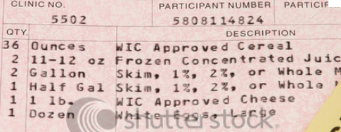
WIC (Women, Infants and Children)
  Who qualifies:
    Children five and under
    Pregnant women
    Postpartum women
    Breastfeeding women
    No citizen requirement
  Participants receive vouchers to purchase specific food items
    Covers: formula, eggs, milk, cheese, peanut butter, baby food, beans, bread, etc.
  To remain eligible must take children to office once a month

Slide 17
SSI (Supplemental Security Income)
Federal income supplement
  Applicant must meet income and disability test
Disability:
  Results in “marked and severe functional limitations”
  Condition must have lasted or expected to last at least 12 months or will result in death
What should be referred to PhilaKids MLP?
  SSI application DENIALS and Terminations less than 60 days old

Slide 18
SSDI
Social Security Disability Insurance
  For workers who have enough qualifying quarters of work with Social Security wages withheld.
  Also need to be determined “disabled”: unable to engage in any substantial gainful activity (SGA) by reason of any medically determinable physical or mental impairment(s) which can be expected to result in death or which has lasted or can be expected to last for a continuous period of not less than 12 months.
  Derivative Benefits are paid to beneficiary’s children.

Slide 19
TANF (Temporary Aid for Needy Families)
  Commonly referred to as welfare
  Cash grant
  Resource limit of $1,000
  All families eligible for TANF are also eligible for food stamps
  Who qualifies:
    Dependent children
    Specified relatives of the child or children
    Pregnant women

Slide 20
TANF
Family Size | Monthly allotment
2 | $330
3 | $421
4 | $514
5 | $607
6 | $687
TANF benefits are approximately 24% of the FPL
Notes:
NEED CURRENT NUMBERS FOR 2PA 014
These are for 2011 from Congressional Research Service report http://www.fas.org/sgp/crs/misc/RL32760.pdf

Slide 21
Ongoing TANF requirements
  Can only receive for 60 months with extensions for hardship (includes domestic violence, mental and physical disabilities)
  Must participate in a welfare to work program (or qualified educational program)
    Families may present with a Caregiver Assessment Form to be excused from this requirement
  Must try to get child support
    Exceptions for domestic violence

Slide 22
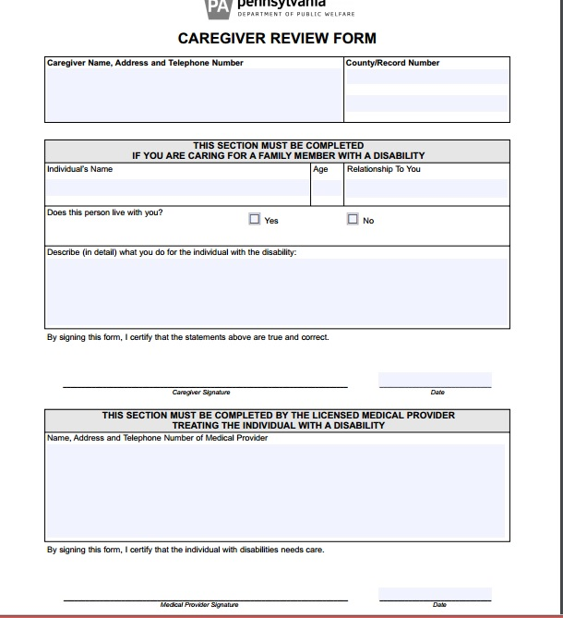

Slide 23
Housing
PHA: Philadelphia Housing Authority – traditional public housing; rent is determined by household income. May also include a utility allowance.
Housing Choice Voucher – Formerly “Section 8”: a rent voucher for an amount determined by household income. Tenants use vouchers to rent from private property owners.
HUD/Project-based – HUD provides the subsidy directly to the property owner. Tenants apply to property owners for rental units.

Slide 24
Medicaid
Who is eligible?
  Meet the citizenship requirements
  Meet the income guidelines
  Many parents aren’t aware of the recent expansion
What can PhilaKids MLP do?
  Medicaid application DENIALS or DELAYS
  Resources on GenPeds
Notes:
Uninsured rate from http://www.pilcop.org/fewer-pa-children-have-health-coverage/

Slide 25
CHIP (Children’s Health Insurance Program)
Free or low-cost health insurance fro children under 19 whose families are not eligible for Medical Assistance
Covers:
  Check ups
  Hospital stays
  Immunizations
  Prescriptions
  Dental
  Vision
  Hearing

Slide 26
Common issues with maintaining benefits
Frequent recertification
  Missed deadlines
Need for supplemental documentation
  Letter of termination of employment
TANF stops but recipient doesn’t ask for SNAP to continue
Frustration with the County Assistance Office

Slide 27
Why is screening so important?
Public benefits impact health
Many eligible families aren’t receiving benefits
  26.5% of eligible Philadephians are not enrolled in SNAP
  15% of eligible Philadelphians do not have health insurance*
  *http://sharedprosperityphila.org/crisis-level/

Slide 28
How can MLP help?
Work with families to address a wrongful denial, reduction, or cessation of benefits
Resource guides on GenPeds
Answer questions

