Slide 1
Teen update
Katie Stroup Mat 2022

Slide 2
Outline
Adolescent Medicine Department
3 programs
How to reach us
PREP
STI treatment updates

Slide 3

Adolescent… Teen Clinic… Family Planning
Moms… Minors
Birth Control…

Slide 4
Consult Specialist Practice
AKA
Who? Patient referred from her own PCP. Just like pulm, cards, etc.
Why? Menstrual issues or management; PCOS; Vulvar complaints
Referral? YES
Parent? Yes if under 18. Confidential history performed with Family Planning services if indicated
Phone tree: 215 427 3802

Slide 5
Family Planning
AKA Teen and Young Adult Center AKA Sexual Health Services
Who: Anyone 13+ who is or may become sexually active
Services: Sexual health education
  STD testing and treatment
  Pregnancy testing and options counseling*
  Contraception, ECP (Pills, Depo, Ring, Patch, Nexplanon, IUD referrals)
Referral? NO!!!
Parent Required? NO
Also: To see FP Add yourself to the patient’s care team - Break the Glass
Notes:
Menstrual issues? Primary reason must be sexual health. Otherwise, refer for consult.

Slide 6
FP CLINIC CARD
PROGRAM # INTO THEIR CELL

Slide 7
Primary Care Practice
Who: Anyone 12-21 who designates Adolescent Medicine as PCP
Why? Teen focused space, sometimes shorter waits for physicals…
Referral? NO
  BUT patients with Medicaid must contact insurance and have PCP re-assigned to an Adolescent Med PCP (choose Adegite or Peter—insurance confused with Stroup)
Parent? YES if under 18 years.
AFTER THE FIRST VISIT Parents may sign a consent allowing minor to be seen without parent physically present (we still call parent to review non-confidential matters)

Slide 8
Also
Patients can be seen until 21 years + 364 days
Office closed on Saturdays
Walk-ins ONLY for: Preg test, HIV test and Plan B
If you need a same day appointment – call over & we will try to accommodate

Slide 9
WHO DO I CALL?
My CUC patient needs in-person STD treatment:
Call Adolescent Nurses:
I have a clinical / management question:
Provider Room: x4443
What number do patients call for appointments?
What is back-line to front desk?
Fax:
Office Director:
215 427 3801
x3803
3801

Slide 10
THESE PATIENTS NEED TARGETED HIV PREVENTION SERVICES
1. Inconsistent or NO condom use
2. Bacterial STI in the past 6 months
3. Patients with HIV+ partners
4. Patients who want info 😊
DO THIS:
CONNECT TO PREP AND EDUCATE ABOUT IT (not just pills!)
HIV TEST TODAY (if they didn’t yet….for any reason!)
COUNSELING ABOUT HIV RISK
A PLAN TO PREVENT HIV
FP services

Slide 11
HIGHEST RISK:
5. Males who have Male sex partners:
VERY HIGH risk for HIV, syphilis, and other STDs
Need the following testing yearly AND after every new sex partner.
***Do as much as you possibly can during their CUC visit
***Get as much contact info- email, school, friend’s cell***
CONNECT TO PREP AND EDUCATE ABOUT IT
HIV testing (rapid or serum)
Syphilis testing
HBsAg, HBV core AB, and HBV surface AB testing
Ensure: Hep A, Hep B and HPV vaccination
Triple Screen” of 3 sites for GC and CT
(Urine = routine teen screening
Pharyngeal Swab – just like strep swab
Rectal Swab – do peri-rectal skin.
Hepatitis A AB
Hep C RNA

Slide 12
Connect to PREP. How?
1. Immediate Handoff – Walk Over
Call PREP cell phone
PREP Coordinator x5240
Immuno Front desk x5284
Secure Chat
2. Give the patient ALL of the info
Pic of PREP Card
Program PREP # into patient’s cell
3. Forward patient info to PREP coordinator
4. Attendings
Secure chat
Call
Dr. Roberta Leguerre (Cell): 267 235 1154
Dr. Dan Conway (cell):
215 840 8116

Slide 13
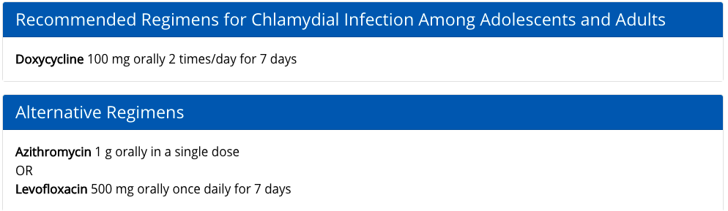
Chlamydia
Notes:
Doxy better for men, better at treating rectal chlamydia
When nonadherence to doxycycline regimen is a substantial concern, azithromycin 1 g regimen is an alternative treatment option but might require posttreatment evaluation and testing because it has demonstrated lower treatment efficacy among persons with rectal infection.
To minimize disease transmission to sex partners, persons treated for chlamydia should be instructed to abstain from sexual intercourse for 7 days after single-dose therapy or until completion of a 7-day regimen and resolution of symptoms if present. To minimize risk for reinfection, patients also should be instructed to abstain from sexual intercourse until all of their sex partners have been treated. Persons who receive a diagnosis of chlamydia should be tested for HIV, gonorrhea, and syphilis. MSM who are HIV negative with a rectal chlamydia diagnosis should be offered HIV PrEP.

Slide 14
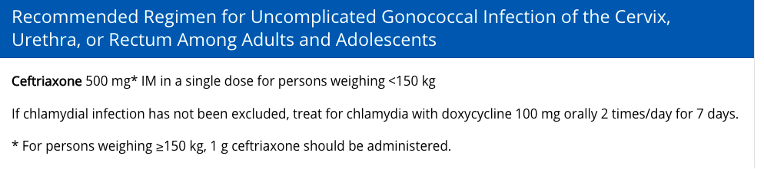
Gonorrhea

Slide 15
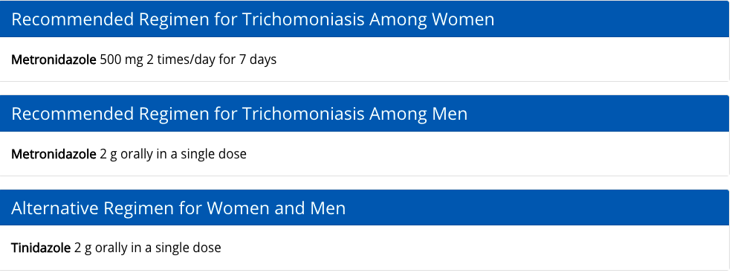
Trichomonas

Slide 16
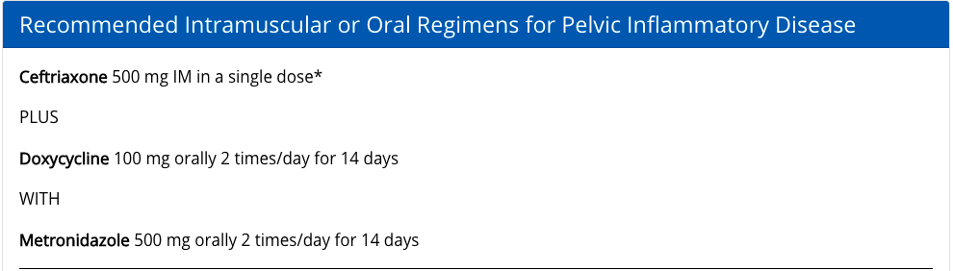
Pelvic Inflammatory Disease
Notes:
Consider Zofran

