Slide 1

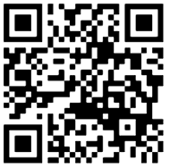
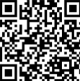
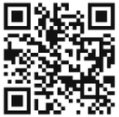
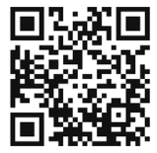
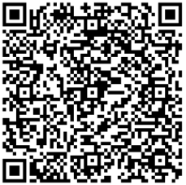
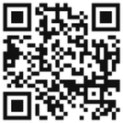
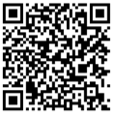
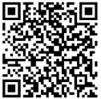
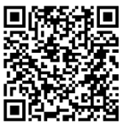
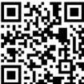
Collaborative Primary Care Newsletter
Resources for Foster Families
CPC Phone Numbers
Nurse Line/Scheduling: 215-427-5985
Bethany, social worker: 215-427-6749
Shlonda, social worker: 215-427-3553
CUC Walk In Sick Clinic
Monday-Friday
8:30-11:30 AM
12:30-3:30 PM
Saturday
8 AM -11:30 AM
Fostering Philly
Sesame Street
Fostering Hope
Guidebooks covering benefits, legal processes, education, and resources
Videos, activities, and resources for made for foster families
Provides concrete resources to foster kids/families including clothes, duffle bags, and phones
SWAN
Tips for Visits: before and after, supervised and unsupervised
Parent Cafés
For families actively in adoption process and permanent legal custodians. Helps connect to support groups, respite care and other resources
Free meet ups/ groups throughout the city for caregivers, parents, and caregivers with foster kids
For teens
Achieving Independence Center
14-23 years old
Scholarships and Grants for College
Youth Valley House
16-21 years old
Housing & support
Foster Club
National network for youth

Slide 2
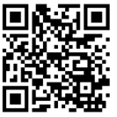
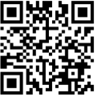
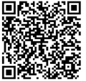
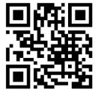
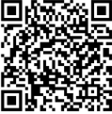
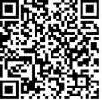
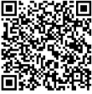
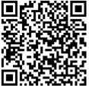
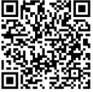
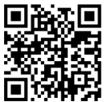
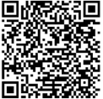
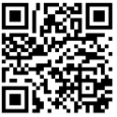
For kinship families additional resources for families in kinship care & grandfamilies, families can connect for additional services
PA KinConnector
GrandFamily Resource Center
Philadelphia Corporation on Aging
Grands as Parents
Free/low-cost resources for everyone
Mental Health
Child Care
School Support
Food
Housing/utilities
Philly Loves Families
Early Intervention
Benephilly
Support services & resource connection
from pregnancy to adulthood
Free evaluations and support connecting to therapies
Many locations throughout the city, see what benefits you qualify for
0-3 years old: Childlink – 215-685-4646
3-5 years old: Elwyn – 215-222-8054

