Slide 1
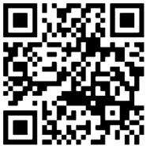
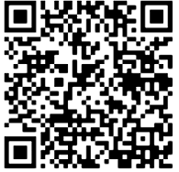
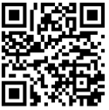
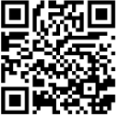
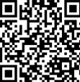
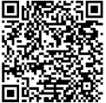
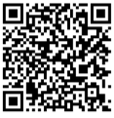
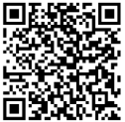
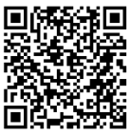
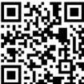
Collaborative Primary Care Newsletter
Resources for Foster Families
CPC Phone Numbers
Clinic Number: 215-427-8116
Michele, nurse coordinator: 215-427-2085
Bethany, social worker: 215-427-6749
Shlonda, social worker: 215-427-3553
CUC Walk-In Sick Clinic
Monday-Friday
8:30-11 AM
1-3:30 PM
Saturday
8 AM -11 AM
Fostering Philly
Resources, information, and support for
Philadelphia area foster families
Benefits
Check you are getting all you qualify for!
Website
Philly Guidebook
Benephilly – free help connecting to benefits
Financial Guide for Resource Parents
For the little ones
Free evaluations, support, and services for concerns about behavior, learning, or development through Early Intervention
0-3 years old: Childlink – 215-685-4646
3-5 years old: Elwyn – 215-222-8054
Sesame Street – videos, activities, and more!
Early Intervention
No referral needed!
For teens
Achieving Independence Center
14-23 years old
Scholarships and Grants for College
Youth Valley House
16-21 years old
Housing & support
Foster Club
National network for youth

Slide 2
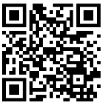
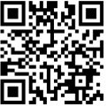
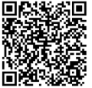
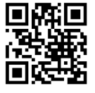
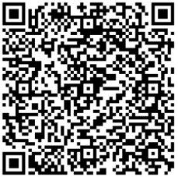
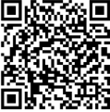
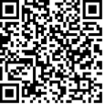
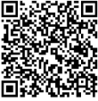
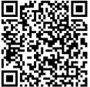
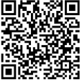
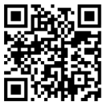
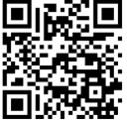
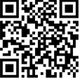
For kinship families additional resources for families in kinship care & grandfamilies, each resources can families connect to additional services or provide support
PA KinConnector
GrandFamily Resource Center
Philadelphia Corporation on Aging
Grands as Parents
Helping children & teens before and after visitation
Free/low-cost resources for everyone
Mental Health
Child Care
School
Food
Housing/utilities
Philly Loves Families
Child Welfare Information Gateway
Fostering Hope
Support services & resource connection
from pregnancy to adulthood
Free resources for lots of types of families involved in foster care
Research, learning tools, and resources

