Slide 1
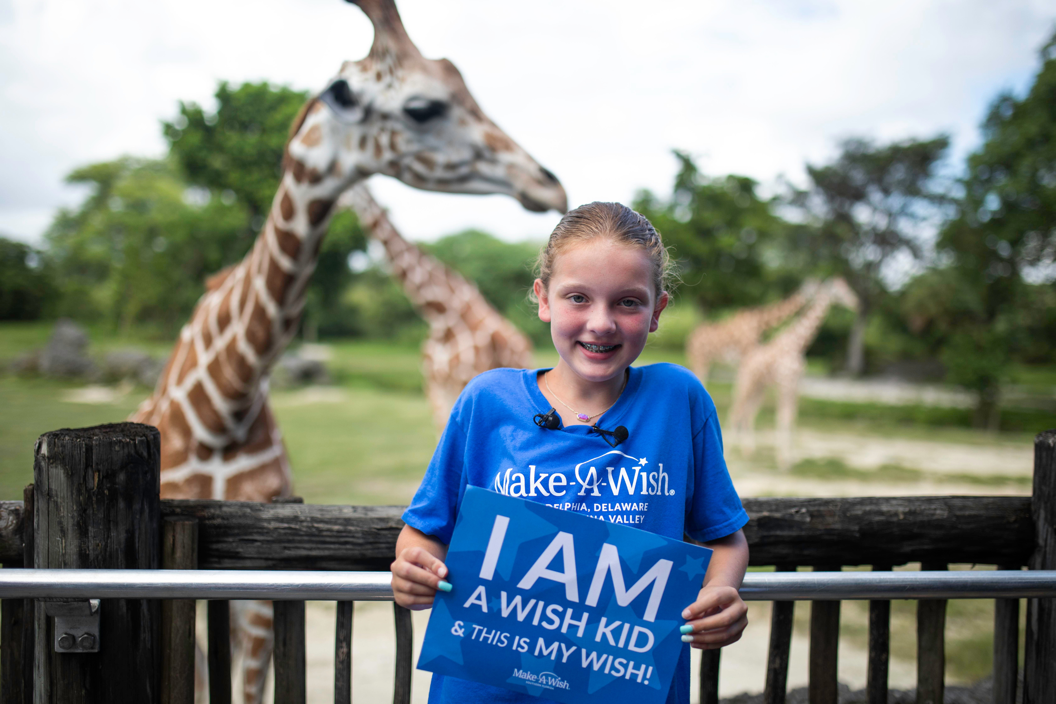


Transforming lives, one wish at a time.
I wish to be a zookeeper
Luci,11
Liver Transplant
July 2025

Slide 2


Slide 3
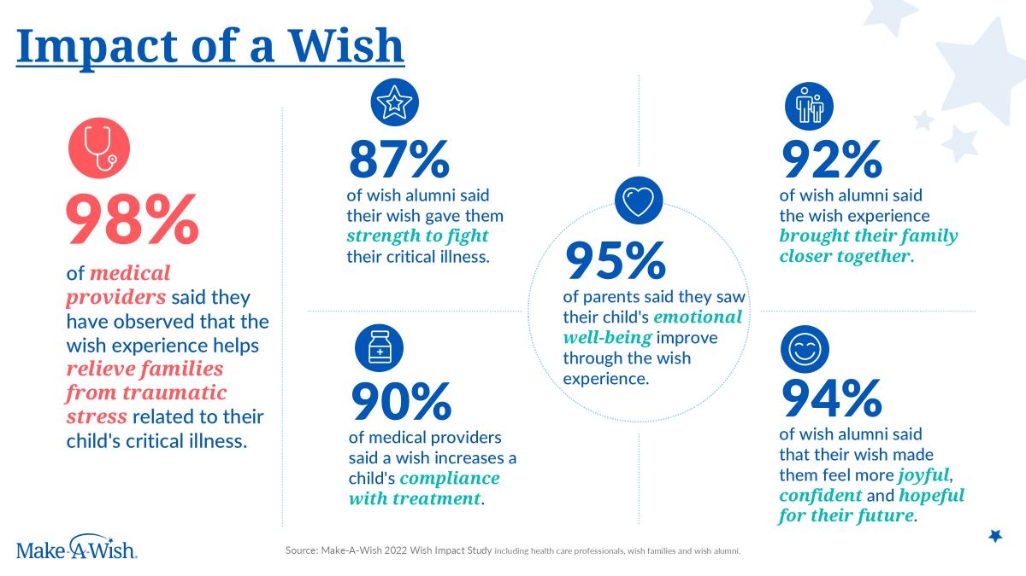

Slide 4








TO QUALIFY FOR A WISH, A CHILD MUST...
Be over the age of 2.5 & under 18 at the time of referral
  Not have received a wish previously
  be diagnosed with a critical illness that is currently placing the child’s life in jeapordy

Slide 5




















Cardiology
Hematology/Oncology
Heart transplant (or actively listed), single ventricle, congestive heart failure, implanted VAD, left ventricular heart failure, status post Fontan procedure, HLHS
Hemophagocytic lymphohistiocytosis, severe aplastic anemia, oncology diagnosis within 1 year of receiving chemo or radiation,
Nephrology
Most Commonly Qualifying Conditions
Gastroenterology
Kidney transplant (or actively listed for transplant), Dialysis dependent renal disease
Liver transplant, chronic liver failure, Hepatopulmonary syndrome, Portal hypertension
Neurology
Genetics
Duchenne Muscular Dystrophy, Leukodystrophy (progressive), Alpers disease, Batten, Moyamoya disease, Rett Syndrome, NBIA, Riley-Day, SMA types 1 and 2
Aicardi Goutieres disease, Bath syndrome, Lesch-Nyhan syndrome, Trisomy 13 and 18, Sanfilippo syndrome (MPS III)
Pulmonology
Rheumatology
Lung transplant, Chronic ventilator dependence, Pulmonary hypertension (active on treatment), Pulmonary fibrosis, pulmonary lymphangiectasia
CINCA, NOMID, Eosinophilic granulomatosis with polyangiitis, Granulomatosis, Microscopic polyangiitis, polyangiitis, Polyarteritis nodosa,Takayasu’s arteritis
Endocrinology
Metabolic
X-linked adrenoleukodystrophy with adrenal or brain findings
Gaucher disease type 2, Krabbe disease, Lesch-Nyhan syndrome, Neimann-Pick disease, Peroxisomal disorders

Slide 6
Conditional Qualifiers
Sickle Cell Disease
Cystic Fibrosis
Epilepsy
BMT/SCT
Sickle cell disease or beta thalassemia with at least one of the following severe or chronic complications:
  End-organ damage requiring additional supportive measures
  History of acute chest syndrome requiring unplanned hospital admission
  History of splenic sequestration/splenectomy
  History of stroke or severe cerebrovascular disease
  Necessary, regular transfusions/transfusion dependent disease
  Pulmonary hypertension
  Repeated severe pain crises requiring unplanned hospital admission or ambulatory management
Cystic fibrosis (pulmonary) with at least one of the following severe or chronic complications:
  Advanced lung disease and/or oxygen dependence
  Not eligible for or intolerant to modulator therapy
  Nutritional failure despite treatment
  Repeated exacerbations in the past 12 months
  Repeated unplanned hospitalizations in the
  past 12 months
  Significant CF-related liver disease
  Significant, recurrent infections
Epilepsy/Lennox-Gastaut/uncontrolled motor seizures that are currently defined by the provider as:
  Tonic, atonic, or tonic-clonic and
  With a failure of two or more anti-seizure medications and
  With continued, repeated breakthrough tonic, atonic or tonic-clonic seizures requiring rescue medication(s) and/or unplanned admission (e.g., approximately one event per month)
  If BMT/SCT occurred under 2.5 years old, the child must have ongoing life-threatening complications
  If BMT/SCT occurred at 2.5 years or older, the child must be either within 5 years of transplant or having ongoing life-threatening complications

Slide 7
CASE REVIEW
5-year-old girl with HLHS
Qualified
3-year-old-boy with congenital heart disease
Requested additional information and learned the patient had:
  completion of 4 mm fenestrated Fontan
  cardiac cath and epicardial pacemaker
Qualified
4-year-old boy with Atrial Septal Defect (ASD)
Requested additional information and learned the patient had:
  no recent unplanned hospitalizations or surgeries
  no critical complications at time of referral
Did Not Qualify

Slide 8
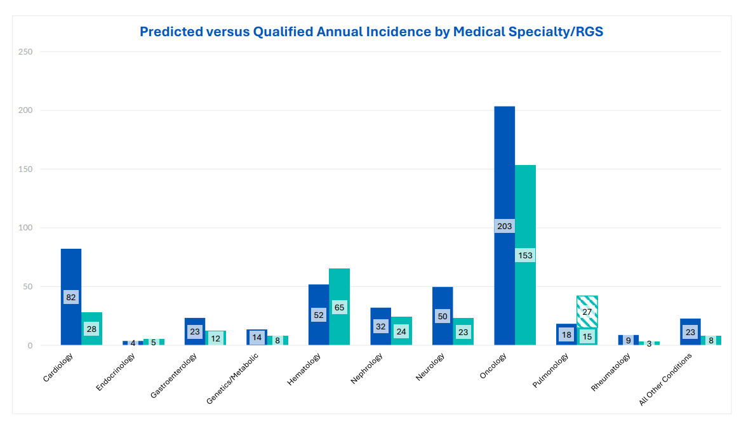
WISH EQUITY: GAPS IN REFERRALS

Slide 9












  Wish Clearance Form
  Referral
wish.org/refer
Medical approval of wish and travel safety
  Diagnosis Verification Form
  Wish Granted!
Emailed to you or best MP, helps determine eligibility
  Wish Discovery & Design!
Welcome Call, Wish Discovery, all details coordinated and costs are covered.
WISH JOURNEY
All wishes begin with a referral. You have the ability to set the wish journey in motion for a deserving child!

Slide 10
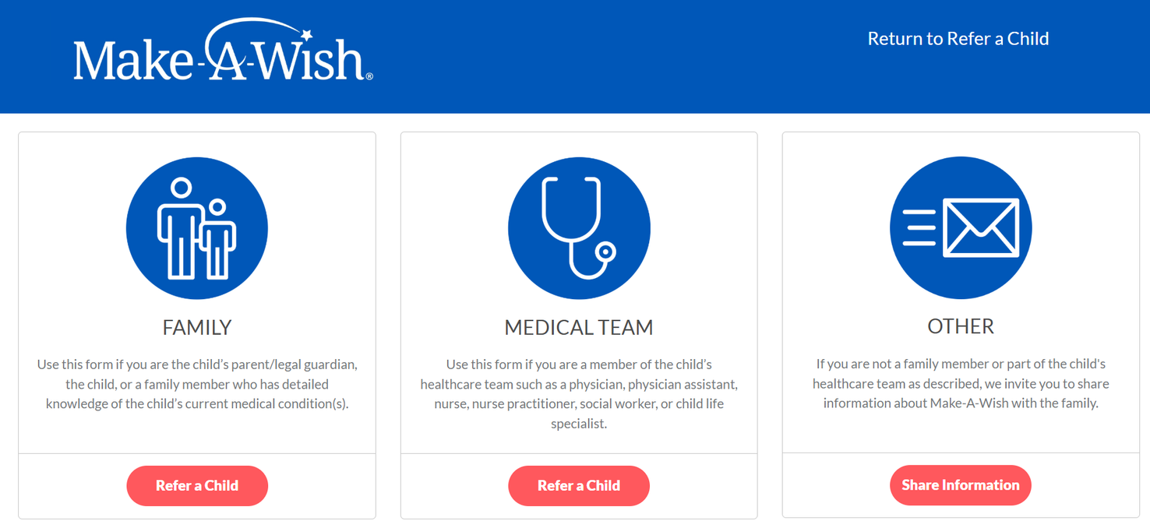
REFERRAL
  13-year-old boy with sickle cell disease
  Recurrent ACS requiring PICU admission, transfusion, supplemental oxygen use and CPAP
  referred by his physician to Make-A-Wish
wish.org/refer
Notes:
S&T

Slide 11
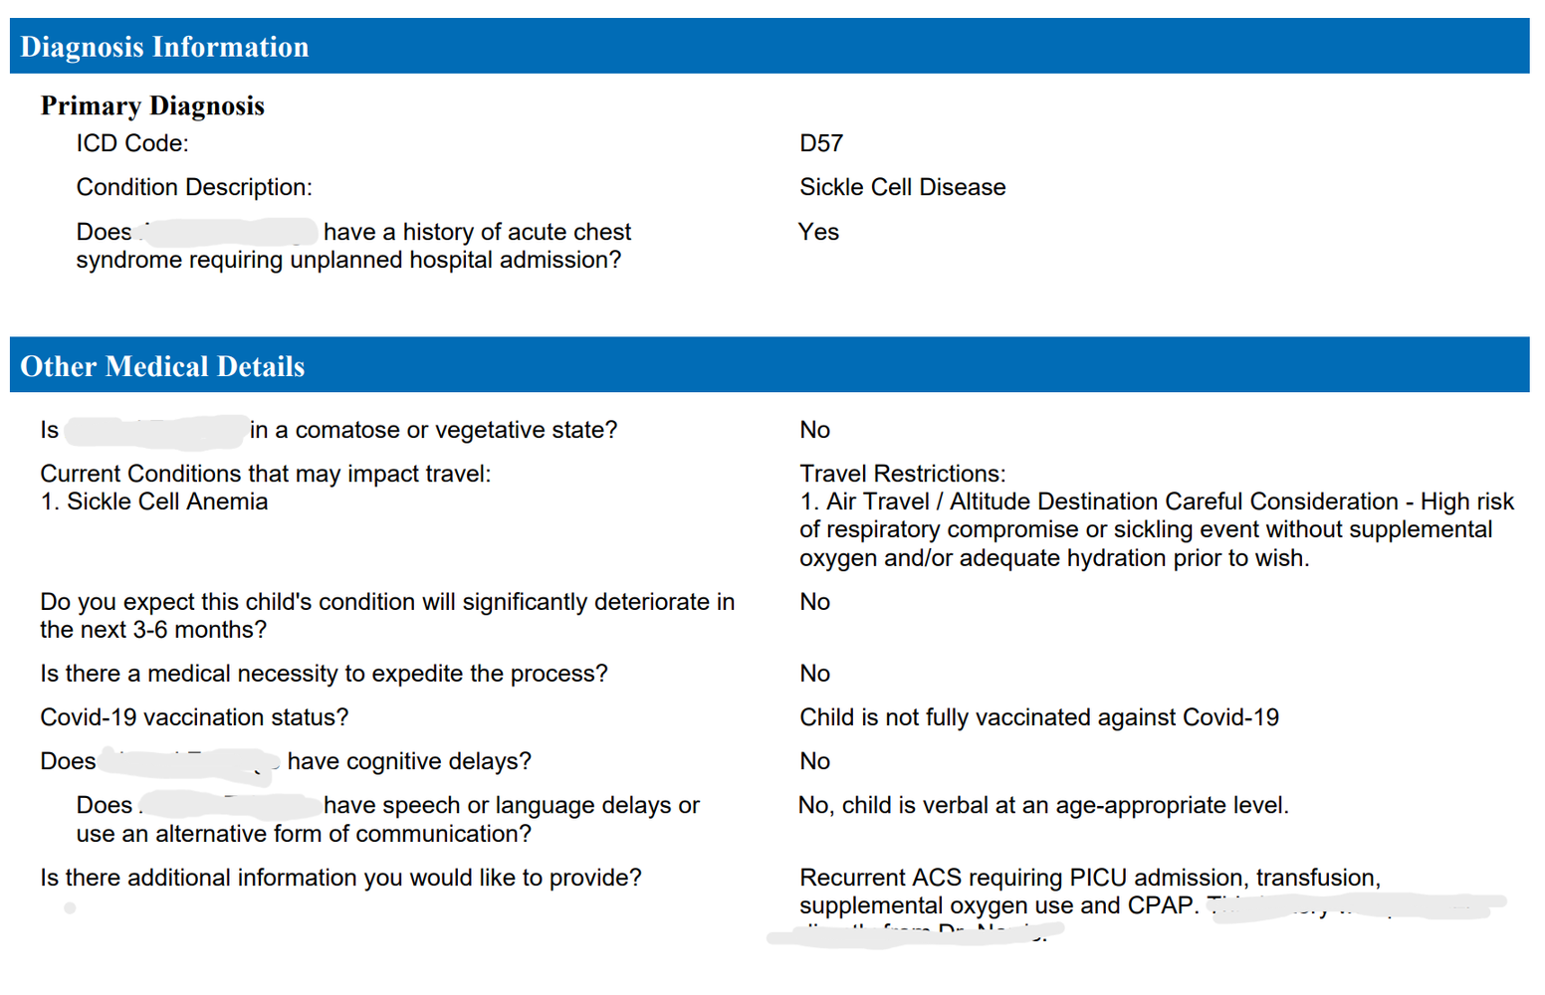
DIAGNOSIS VERIFICATION FORM

Slide 12
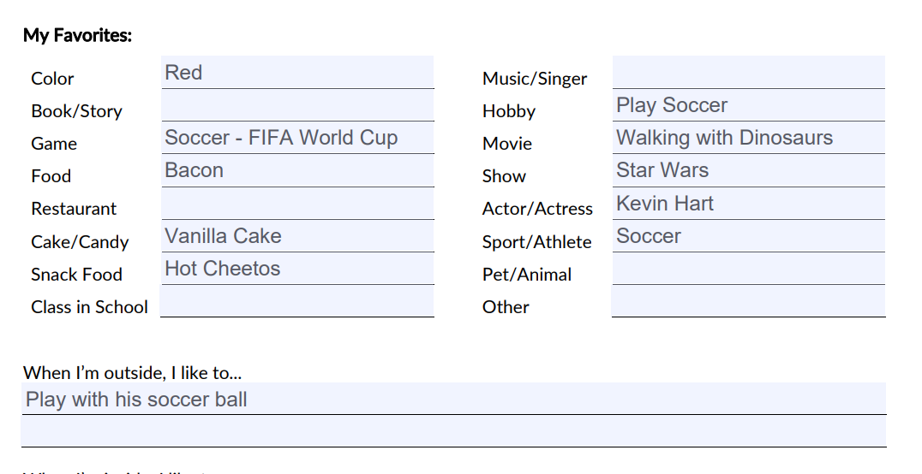
WELCOME CALL
  Gather demographic information, basic information about the child’s interests, and medical needs
  Welcome the family to Make-A-Wish and explain the mission and Wish Journey
WISH DISCOVERY INTERVIEW
  Volunteers or staff work with the child to get to know them and determine their Wish!

Slide 13
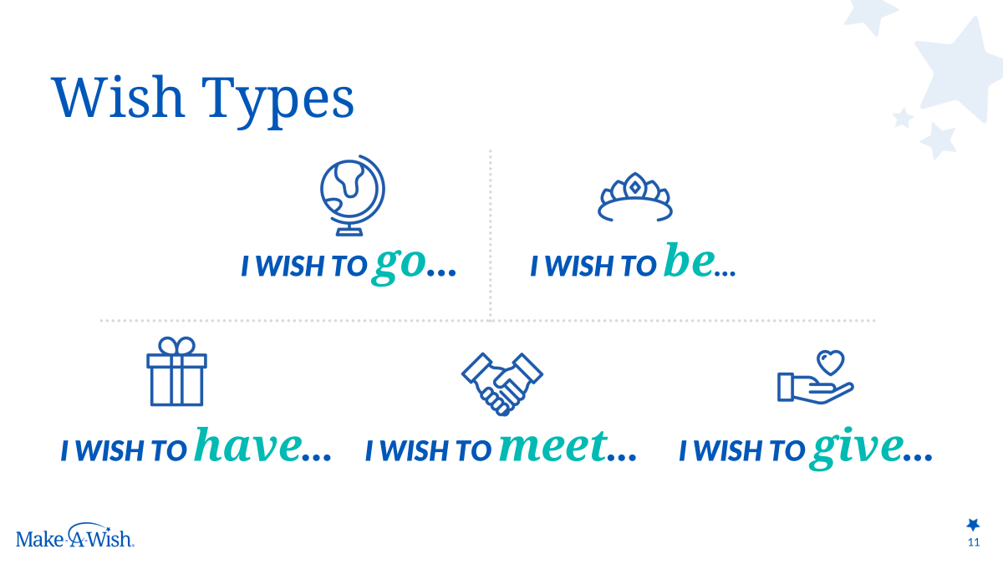
WISH DESIGN
“I wish to be a professional soccer player...”

Slide 14
WISH EQUITY: BARRIERS TO RECEIVING A WISH
  Suitcases and/or attire
  IDs required for travel (ex: passports or REAL ID)
  Transportation
  Access to technology to complete paperwork or navigate travel
  Language
  Lost wages
  Travel with a medically complex child

Slide 15
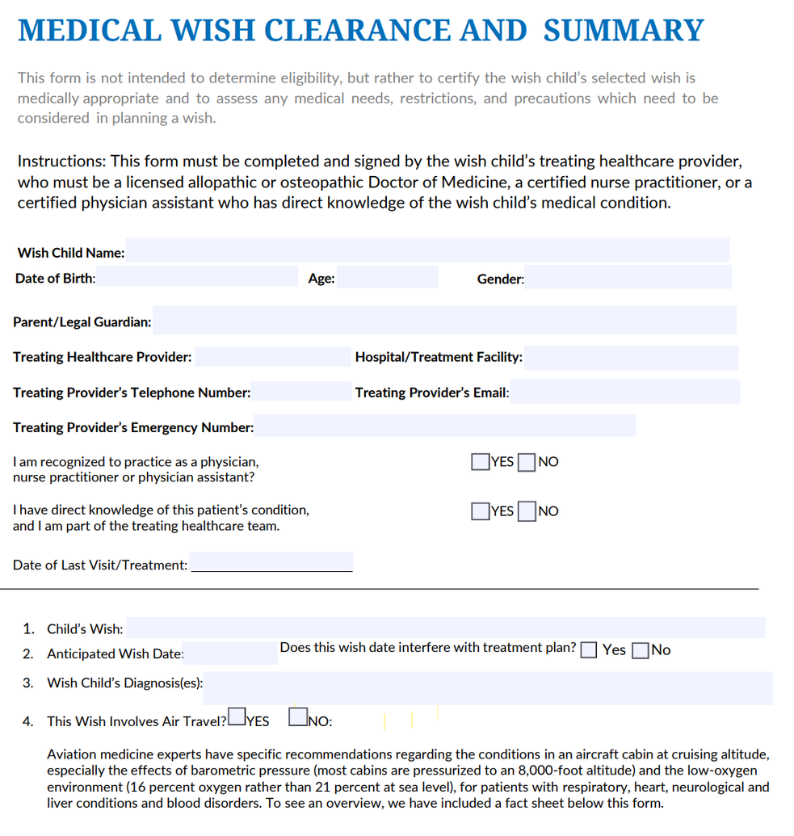
WISH CLEARANCE FORM
  confirms medical team supports the Wish and determines it to be safe and appropriate
  provides necessary information regarding medical equipment and services on the Wish

Slide 16
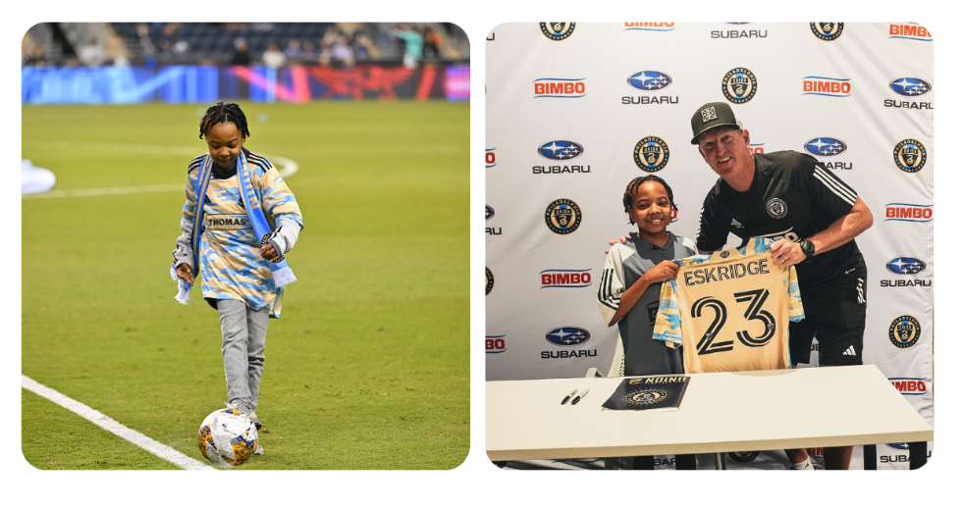
WISH GRANTED
Ahmad’s dream of becoming a professional soccer player came true! He signed a one-day contract, trained with the team, joined them for meals, participated in drills, and led the first kick on match day—complete with a jersey, a limo ride, and even season tickets for his family.

Slide 17

Caroline Camp
Medical Affairs and Program Specialist
ccamp@philadesv.wish.org
Phone: 215.987.3104
Stephanie Widjaja and Thinna Svetanant
ts3588@drexel.edu | stw72@drexel.edu
Bridging the Gaps Interns and M.D Candidates, Drexel University College of Medicine

